Slide 1

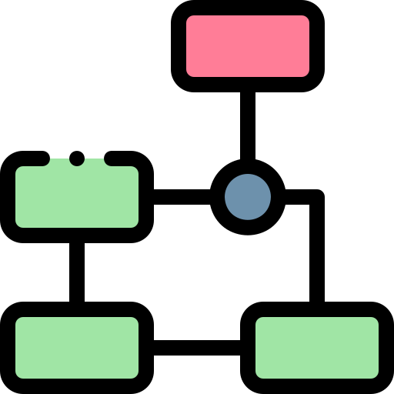






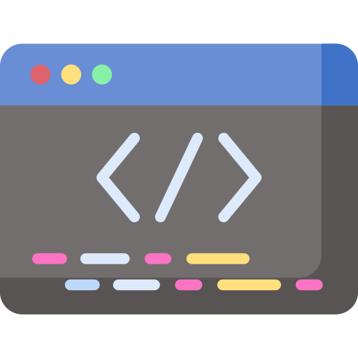

UML
CLICK UP
FIGMA
WEBSITE
PREPERATION:
HADI SHOUMAN
CHAKER YAAKOUB
IBRAHIM MOUSTAFA
HASSAN NAJEM

Slide 2
Hello Every One
Before we begin presenting our presentation, we’d like to inform you that the presentation serves as a website that we’d been working on

Slide 3





UML
Definition
About me I will share with you all about works I delivered
UseCase Diagram
Activity Diagram
Definition:
The Unified Modeling Language (UML) is a general-purpose modeling language in the field of software engineerin which is designed to provide a standard way to visualize the design of a system.
We are the main titles project icons that represents what our project used programs
UML
Use case
Sequence
Scenario
Activity
Class
We are the
Subtitles
Like this way you can reach any slide you want
My apologies for interrupting you sir, however I still have an option that I would like to present to you

Slide 4
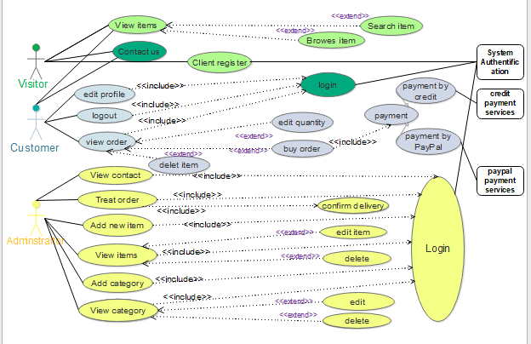
UML
DEFINITION
UseCase Diagram
Sequence Diagram
UseCase Diagram:
is in uml alogorithim that represent what the actor can do

Slide 5
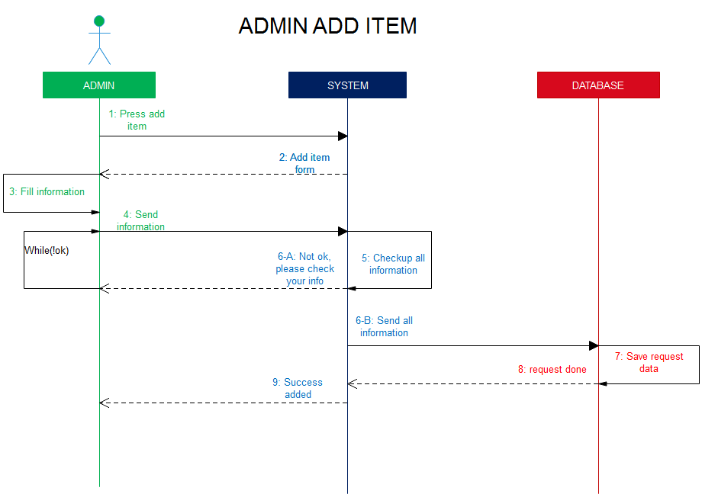
UML
DEFINITION
UseCase Diagram
Sequence diagram

Slide 6
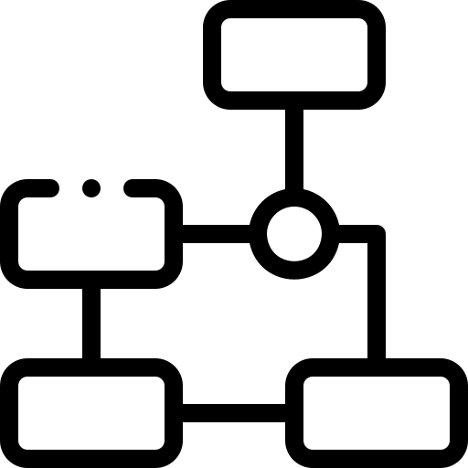
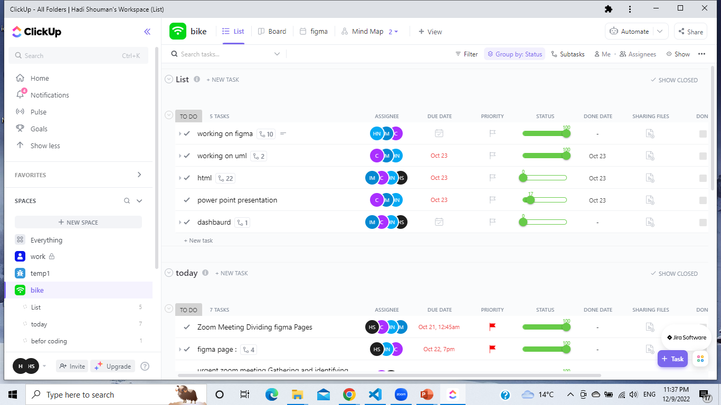
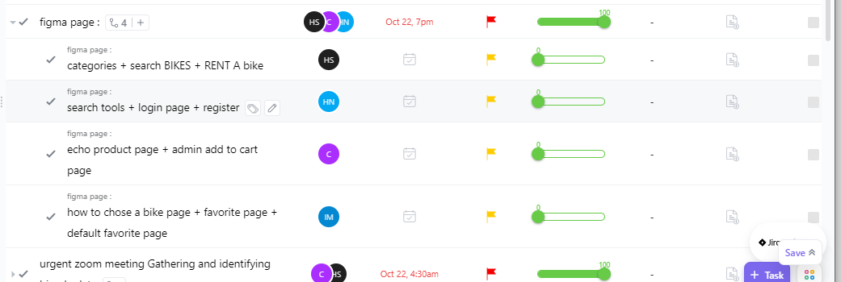
ClickUp
Pressing on this point
ClickUp:
ClickUp is our project management system me and my team classified everyone mainjub
Classified each one main job
This is our main click up main page that’s represents all job titles that’s done
Those are our main
Titles Jobs

Slide 7
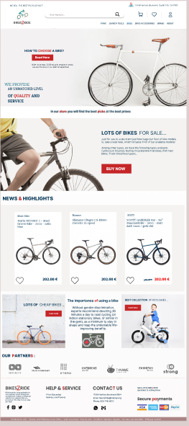
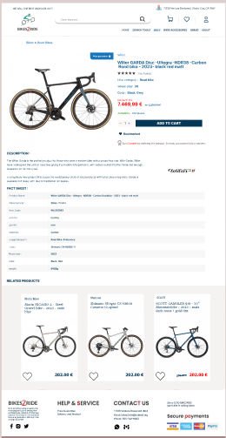
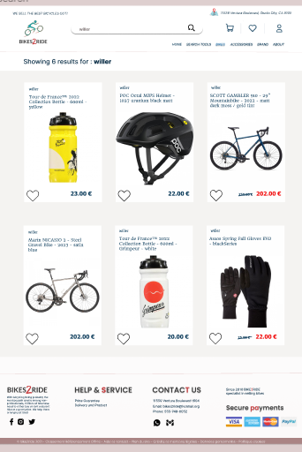
Figma
Chaker Yaakoub
Home page
Echo bike page
Search page
Hadi Shouman
Ibrahim Moustafa
Hassan Najem

Slide 8
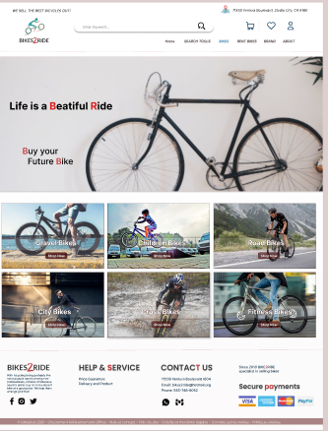
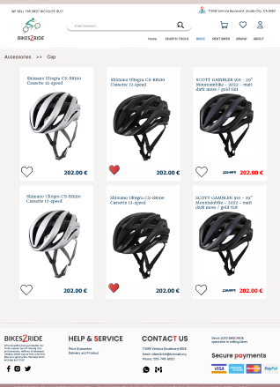
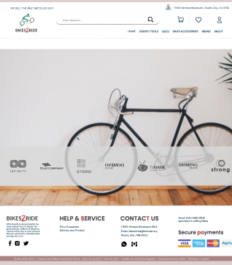
Figma
Chaker Yaakoub
Hadi Shouman
Partner page
bikes page
Product page
Ibrahim Moustafa
Hassan Najem

Slide 9
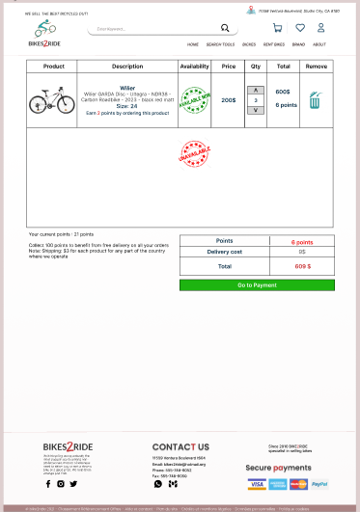
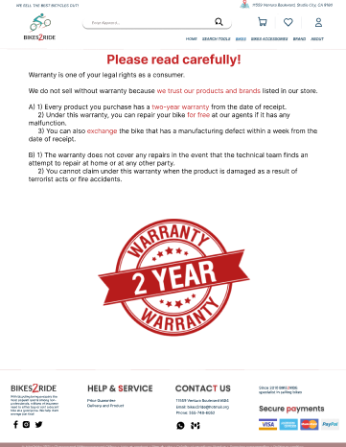
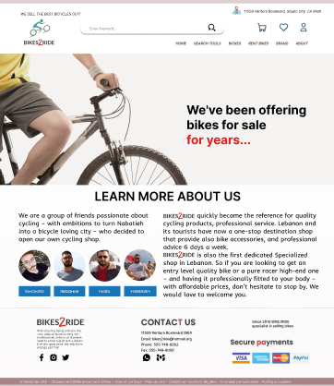
Figma
Chaker Yaakoub
Hadi Shouman
About US Page
My Cart Page
Warranty Page
Ibrahim Moustafa
Hassan Najem

Slide 10
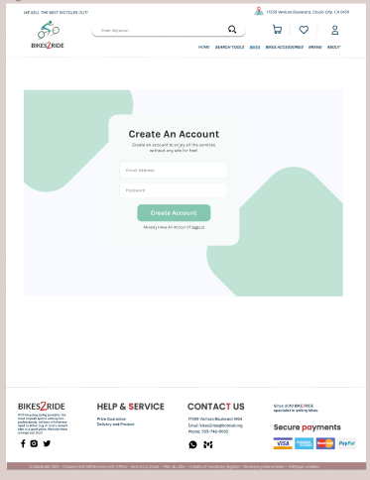
Figma
Chaker Yaakoub
Hadi Shouman
Ibrahim Moustafa
Registration page
Hassan Najem

Slide 11


coding

